Slide 1
README
BURN AFTER READING
about_SlideDeck
The actual presentation starts with slide 6 ("Session title"). The first five slides have a purely organisational purpose. During the break before your session, you should start the presentation with slide 2 ("Next up"), so that the audience knows that they are in the right room. It's fine if you start chatting with the audience during this break, but we need a precise starting point for your presentation in terms of editing your video. That means:
The recording of your presentation will start after the countdown. Please (RE)START talking after the countdown, not during it! Otherwise your recording will start with a half sentence.
It is not necessary to explicitly signal to the PA operator, this is your signal!
Finally, do you have to use this slide deck? No, you are free to present the way you like it. But you are asked to use the intro slides: countdown, session title, sponsor slide. Beyond that, use what is good for the cause – from no slides to sketches from your children, from Jupyter to $youNameIt.
You will find additional information in the notes below.
Sincerely, your hosts!
Dear Speaker, we are thrilled and honored to have you with us in Antwerp in 2024. Take your time and read this before you prepare your session.
Since most of you have been with us before, you will already know a lot about PSConfEU. You know that we try to capture all sessions carefully and publish your work on YouTube. There are a few easily avoidable stumbling blocks that we would like to draw your attention to:
Your screen resolution should be 1920x1080 px (FullHD)
You should provide a full size HDMI socket
Mirror your screen
Disable "Presenter View" in PowerPoint
Using MAC or Surface book? Be aware of HDCP!
Notes:
The fine print (additional information)
Why should you care about HDCP?
"High-bandwidth Digital Content Protection (HDCP) is a form of digital copy protection developed by Intel Corporation to prevent copying of digital audio and video content as it travels across connections. Types of connections include DisplayPort (DP), Digital Visual Interface (DVI), and High-Definition Multimedia Interface (HDMI), as well as less popular or now deprecated protocols like Gigabit Video Interface (GVIF) and Unified Display Interface (UDI)."
https://en.wikipedia.org/wiki/High-bandwidth_Digital_Content_Protection
Some notebooks ignore the HDCP standard, some vendors comply with the standard. Apple and Microsoft are somehow famous for strictly following the HDCP guidelines. Sadly, we will not be able to guarantee, that your session can be recorded in the latter case.
But you can do simple things, to overcome these problems. It is also very likely that you presented with your notebook before. So you will know, if this worked fine.If you are in doubt and if the agenda allows, try a dry-run a day before and connect everything.
In general you can easily bypass HDCP restrictions with a cheap splitter (the cheaper the better), just like the one you see below. This is an example device that we bought for 16 euros (in Germany).
Ask us, we will lend you such a device.
Thorsten also gave a whole presentation about "Broadcasting yourself" - easy steps to record yourself and create a (backup) session recording on your own. If you want to invest your time and dive deeper, take a look at his recordings and notes:
https://vimeo.com/thorstenbutz/byourself
This is of course completely voluntary, but perhaps you will find it helpful.

Slide 2
Next Up:
Steve Lee

Slide 3
3
3

Slide 4
2

Slide 5
1

Slide 6
DSC v3 – The Next Generation
Steve Lee

Slide 7

Many thanks to our sponsors:

Slide 8
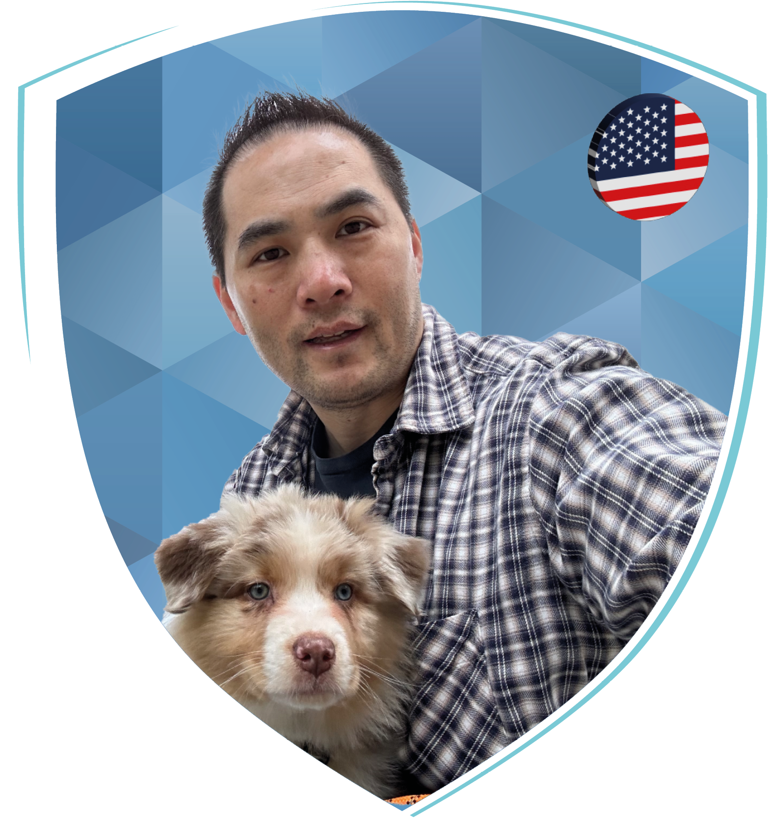
Steve Lee
Principal Software Engineer Manager at Microsoft for: - PowerShell 7 - DSC v3 - Win32 OpenSSH - PowerShellGallery - PS VSCode extension, PSSA, SecretMgmt, etc…

Slide 9

A Brief History Lesson

Slide 10
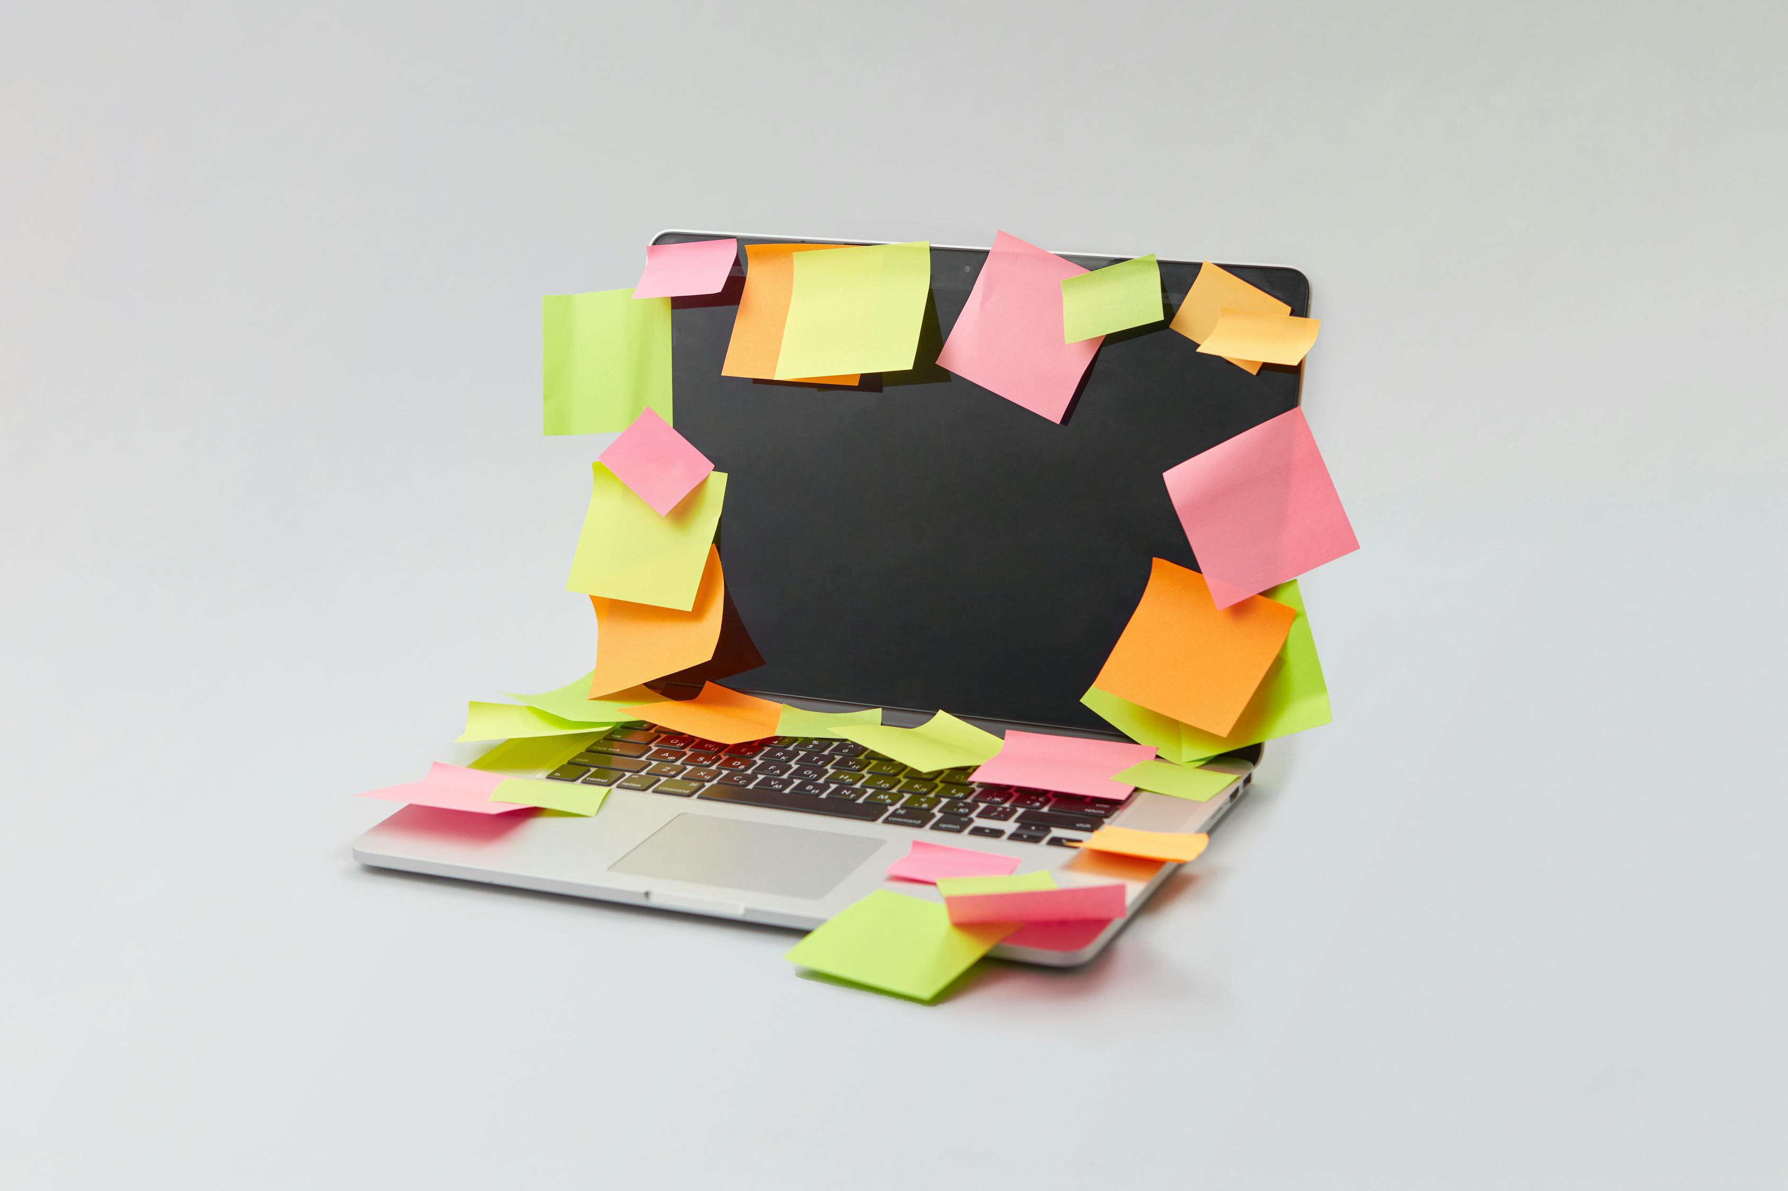
In the beginning…
Manual processes
Single systems
Fragile

Slide 11
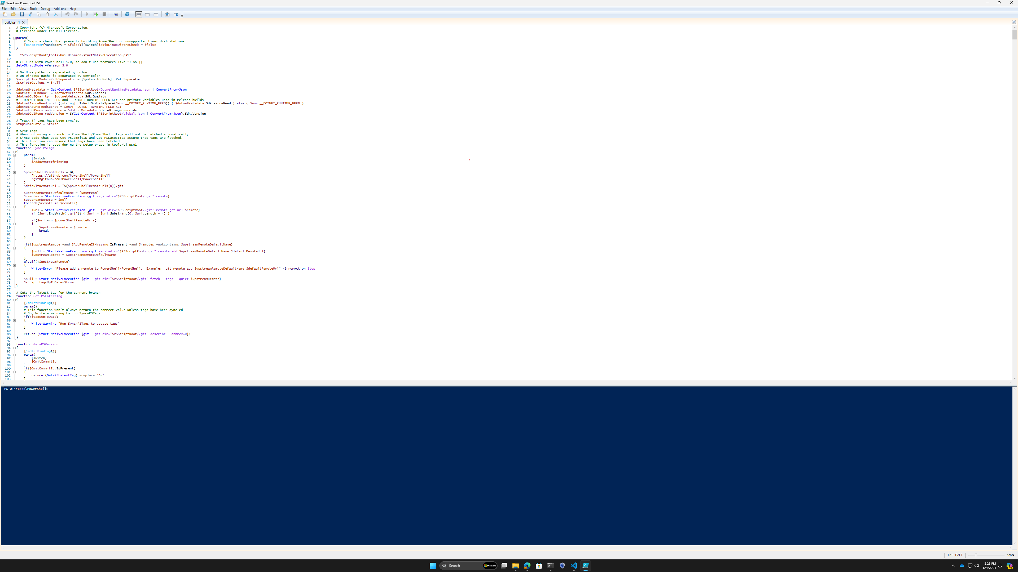
Scripting!
Inconsistency
Error prone
HUGE!

Slide 12

Configuration as code
Shift complexity to resources
Focus on declaring desired state

Slide 13
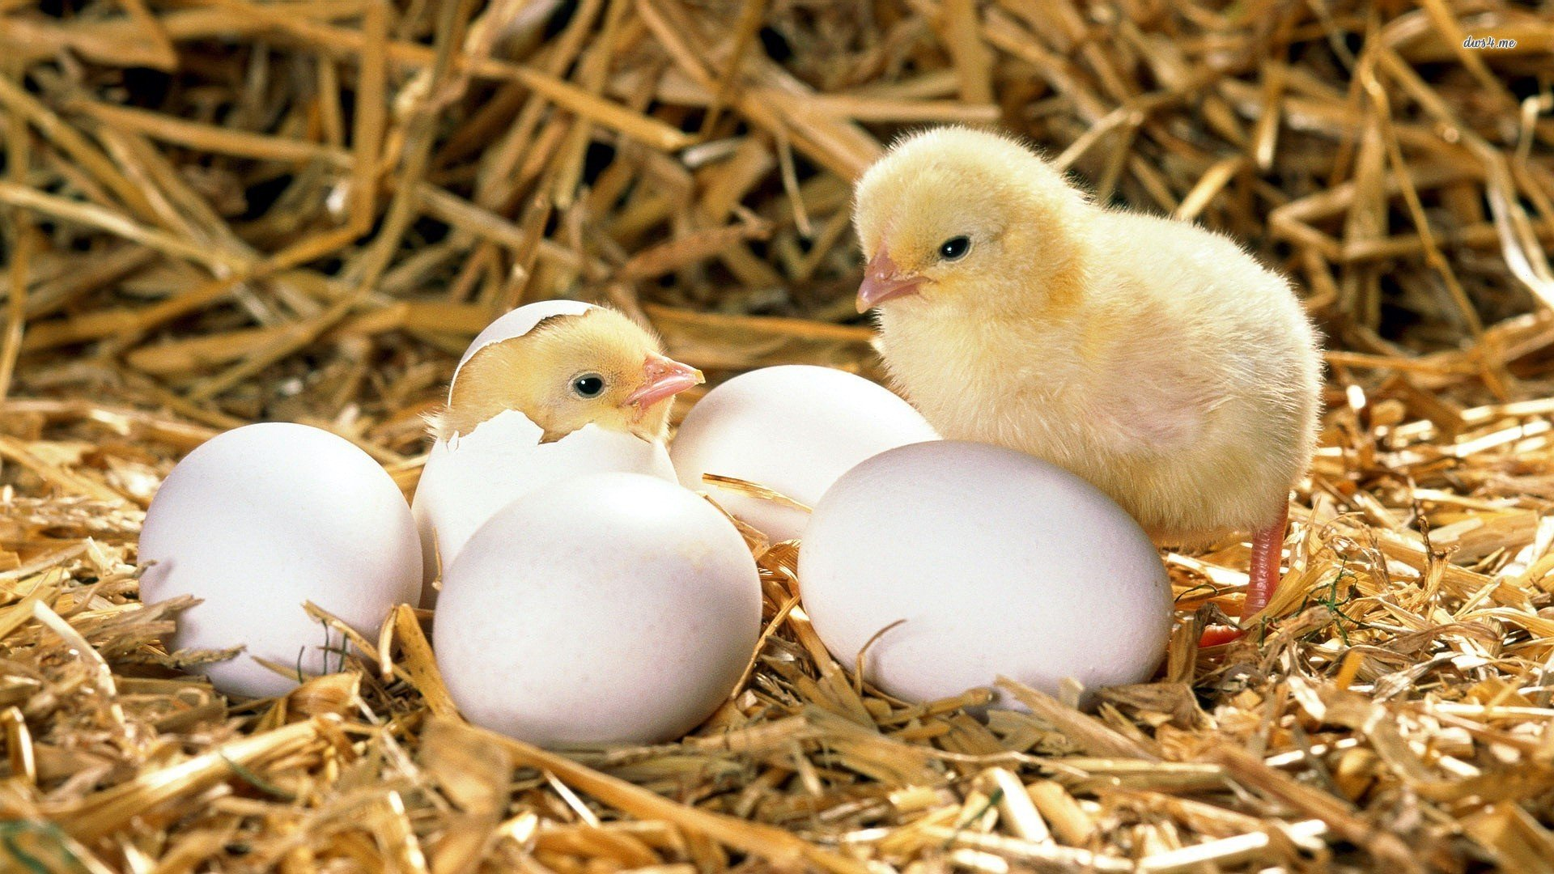
Then came DSC

Slide 14
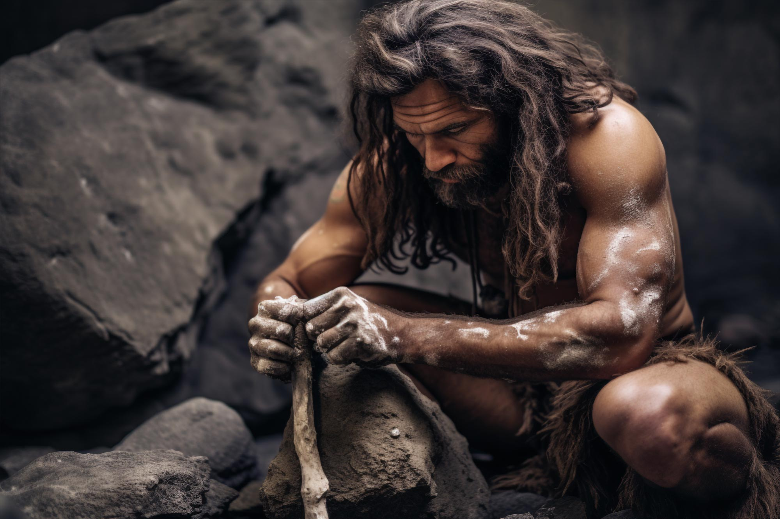
DSC v1
Windows focused (very limited Linux support)
Local Configuration Manager (LCM)
WMI, PowerShell script, PowerShell class resources
Get, Set, Test
MOF configuration and schema

Slide 15
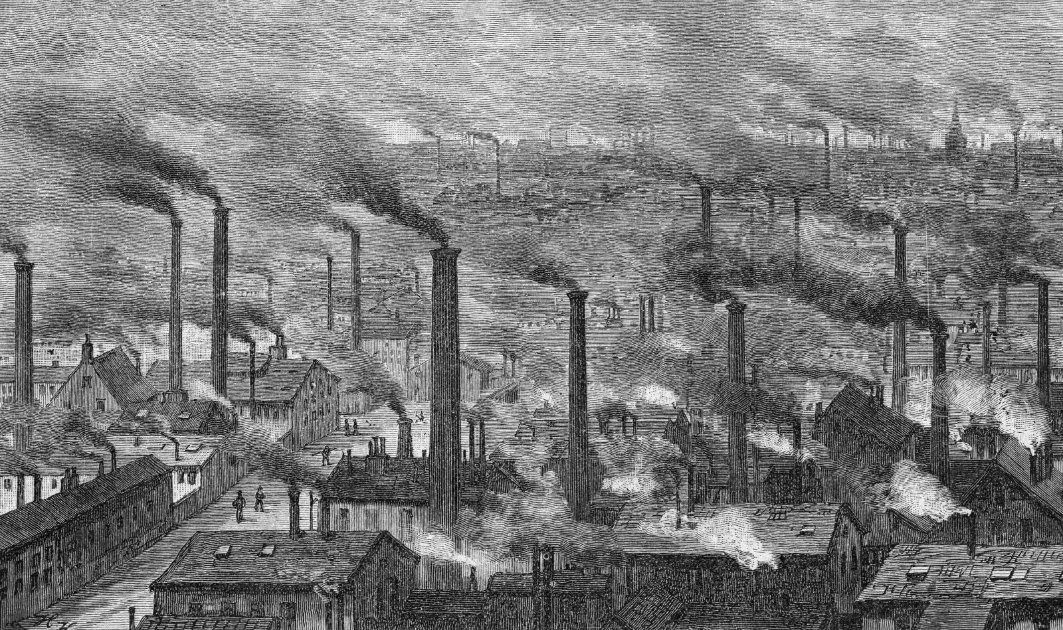
DSC v2
PSDesiredStateConfiguration module
No LCM -> Bring your own agent
Cross-platform support (via PowerShell 7)
Open Source
Invoke-DSCResource
Start of decoupling DSC from PowerShell

Slide 16
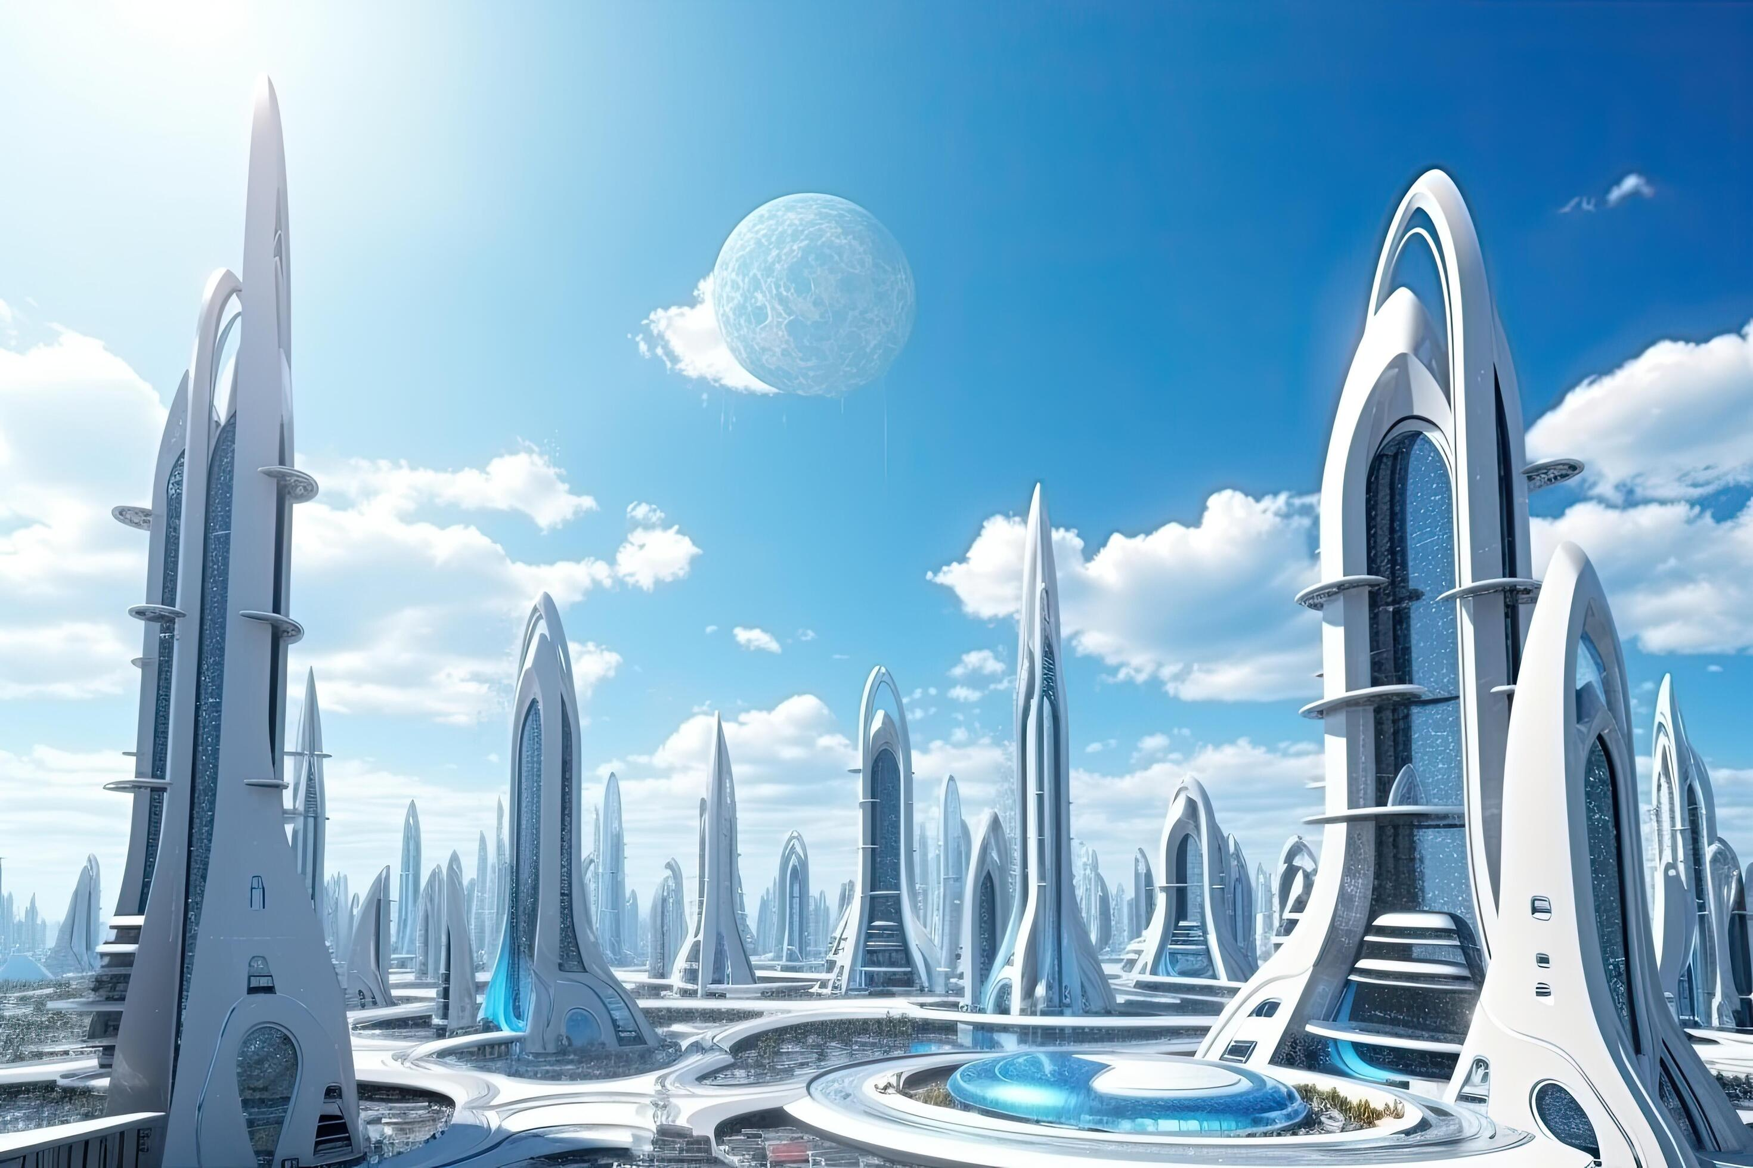
DSC v3
A reimagining of DSC: revolutionary, not evolutionary
Cross-platform and Open Source
Decoupled from PowerShell
WinPS5.1 and PS7 resources supported
Resources written in any language
No more MOF -> JSON
Get, Set, Test, Export, and more!

Slide 17
Demo outline
Anatomy of a v3 resource
DSC command-line tool
Configuration documents
Using PowerShell based resources
Linux example
Windows example

Slide 18
Demos
We love Demos!

Slide 19
Key takeaways
DSC v3 enables new resources ecosystem
New resource capabilities for PowerShell class-based resources
Modernized configuration format build on ARM and JSON with future Bicep support

Slide 20
3.0 and beyond
3.0 GA targeting late Q3 2024
3.1 ideas
Bicep
PowerShell tooling to author configurations
DSC.exe as an agent
Resource discovery/publishing to ACR

Slide 21
Q&A
15 minutes

